Slide 1
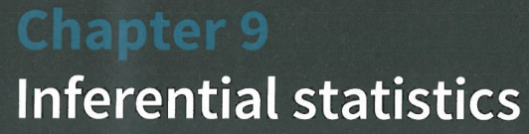

Slide 2
Main topics in this chapter:
Formulate and carry out a hypothesis test concerning the population mean for a small sample using the t-test
Formulate and carry out a hypothesis test concerning the difference in population means, using:
a two-sample z-test with large samples
a two-sample t-test with small samples
a paired sample t-test with small samples
Determine confidence intervals for population means based on small samples using the t-distribution
Determine confidence intervals for the difference in population means

Slide 3
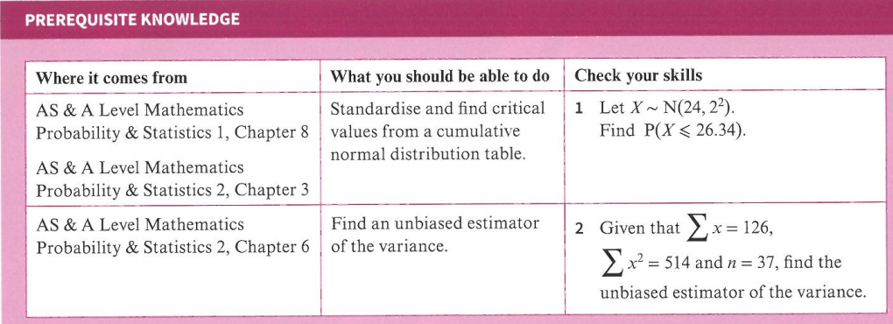
Test your knowledge

Slide 4
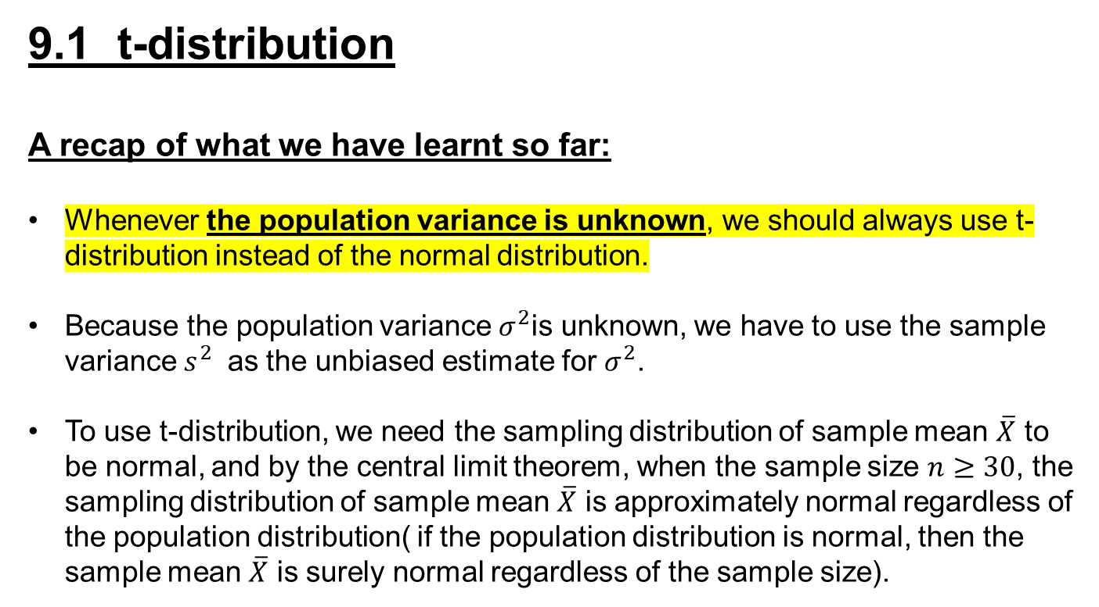
9.1 t-distribution
A recap of what we have learnt so far:
Whenever the population variance is unknown, we should always use t-distribution instead of the normal distribution.
Because the population variance $σ^{2}$is unknown, we have to use the sample variance $s^{2}$ as the unbiased estimate for $σ^{2}$.
To use t-distribution, we need the sampling distribution of sample mean $\overline{X}$ to be normal, and by the central limit theorem, when the sample size $n≥30$, the sampling distribution of sample mean $\overline{X}$ is approximately normal regardless of the population distribution( if the population distribution is normal, then the sample mean $\overline{X}$ is surely normal regardless of the sample size).

Slide 5
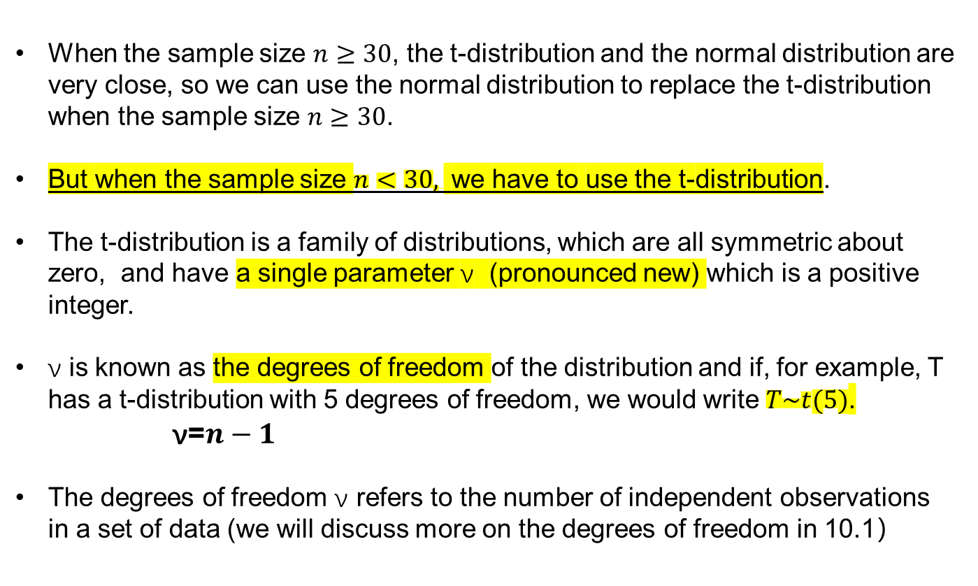
When the sample size $n≥30$, the t-distribution and the normal distribution are very close, so we can use the normal distribution to replace the t-distribution when the sample size $n≥30$.
But when the sample size $n<30,$ we have to use the t-distribution.
The t-distribution is a family of distributions, which are all symmetric about zero, and have a single parameter ν (pronounced new) which is a positive integer.
ν is known as the degrees of freedom of the distribution and if, for example, T has a t-distribution with 5 degrees of freedom, we would write $T\sim t(5)$.
$\text{ν}$=$n−1$
The degrees of freedom $\text{ν}$ refers to the number of independent observations in a set of data (we will discuss more on the degrees of freedom in 10.1）

Slide 6
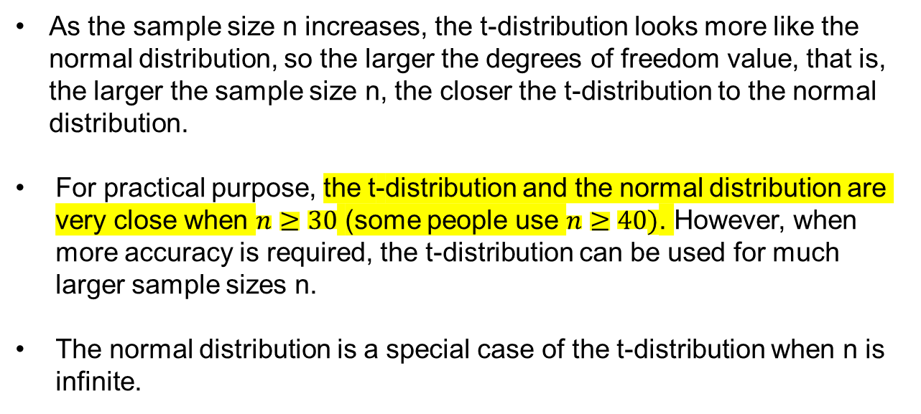
As the sample size n increases, the t-distribution looks more like the normal distribution, so the larger the degrees of freedom value, that is, the larger the sample size n, the closer the t-distribution to the normal distribution.
For practical purpose, the t-distribution and the normal distribution are very close when $n≥30$ (some people use $n≥40)$. However, when more accuracy is required, the t-distribution can be used for much larger sample sizes n.
The normal distribution is a special case of the t-distribution when n is infinite.

Slide 7
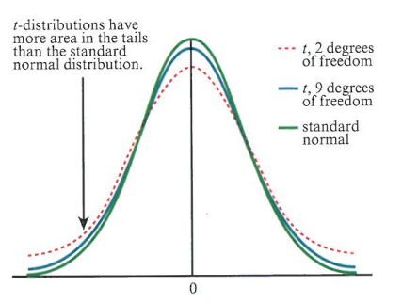
The t-distribution is different from the normal distribution because the density in the tails is greater than the density in the tails of the standard normal distribution. This means that the t-distribution has greater probability in the tails and less probability in the center compared to the standard normal distribution.

Slide 8
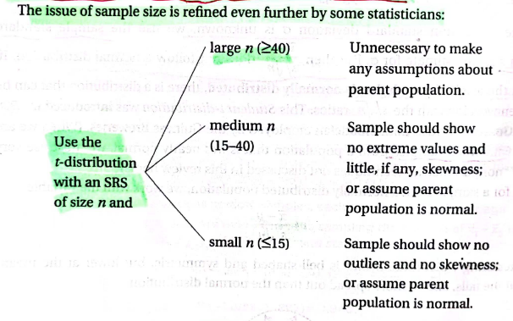
SRS-Single Random Sample

Slide 9
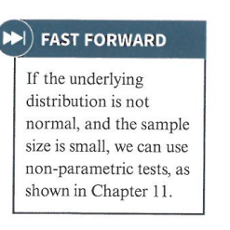
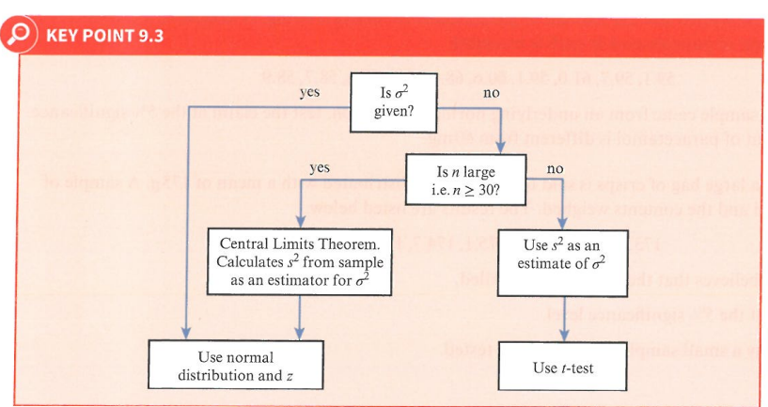
The population is normal

Slide 10
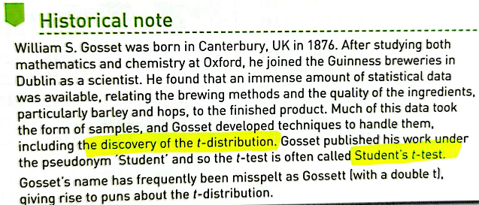

Slide 11
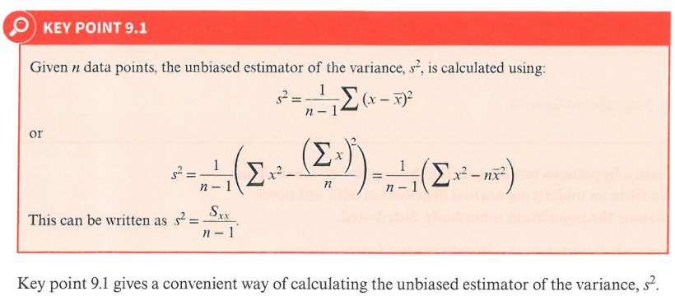
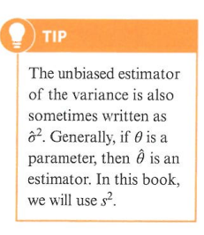
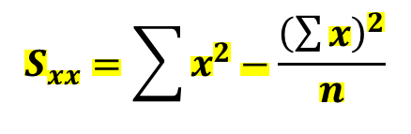
$$S_{xx}=\sum{x^{2}−\frac{{\left(\sum{x}\right)}^{2}}{n}}$$

Slide 12
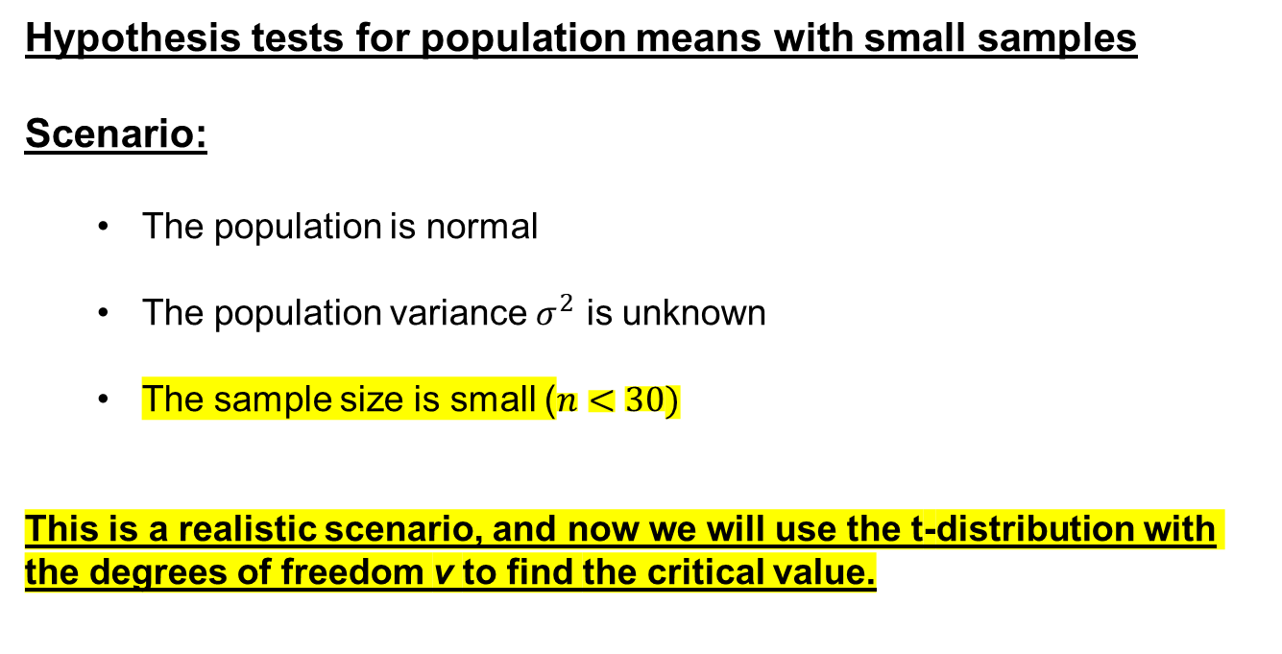
Hypothesis tests for population means with small samples
Scenario:
The population is normal
The population variance $σ^{2}$ is unknown
The sample size is small ($n<30)$
This is a realistic scenario, and now we will use the t-distribution with the degrees of freedom v to find the critical value.

Slide 13
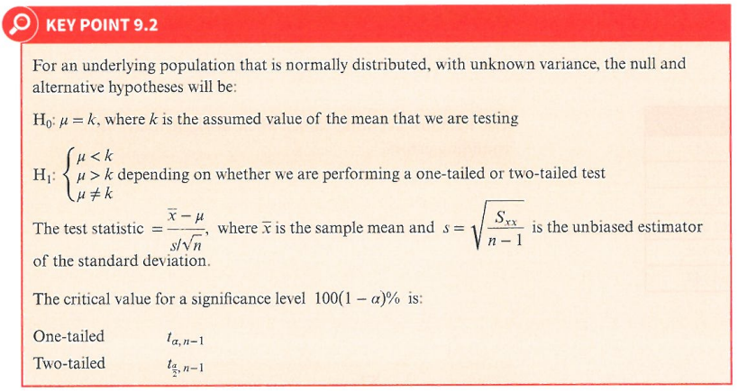
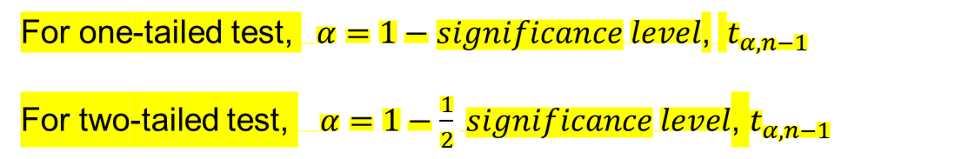


$$n<30$$
$$degrees of freedom ν=n−1$$
confusing, ignore it, using the ones below
For one-tailed test, $α=1−significance level$, $t_{α,n−1}$
For two-tailed test, $α=1−\frac{1}{2} significance level$, $t_{α,n−1}$

Slide 14
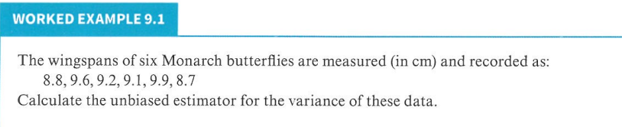

Slide 15
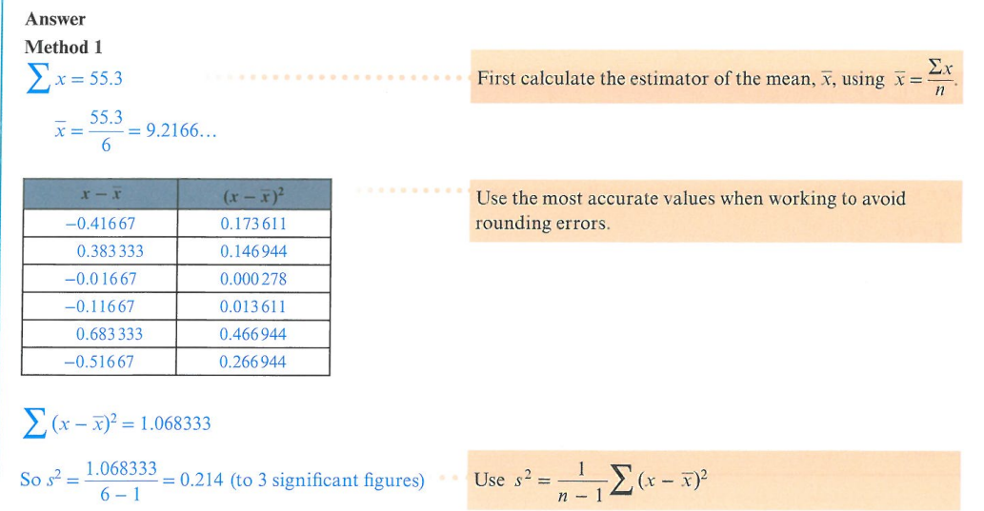

Slide 16
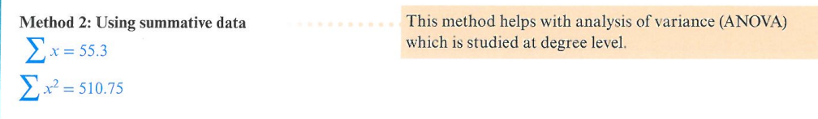
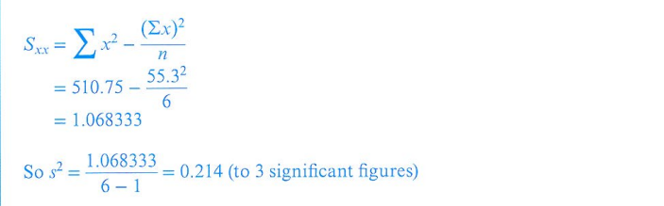

Slide 17
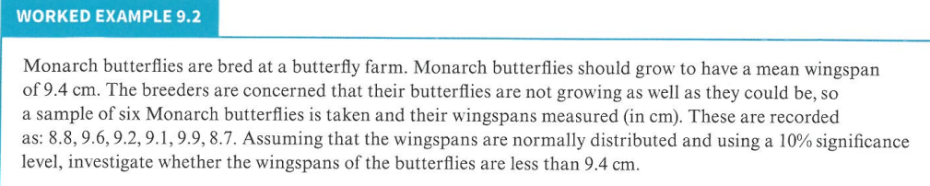
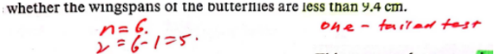

Slide 18
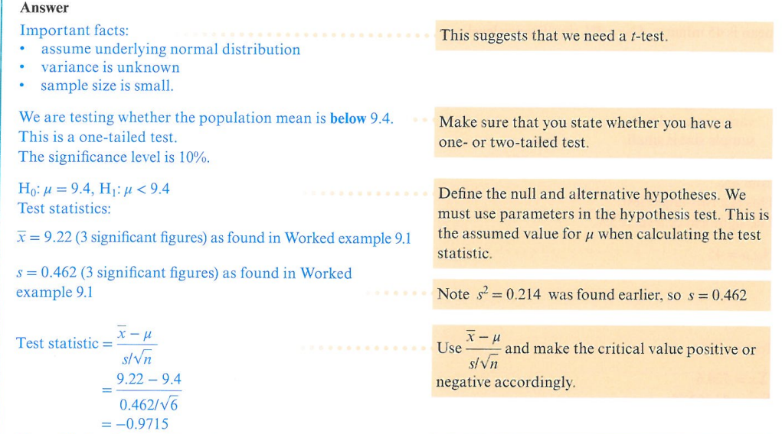
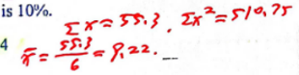
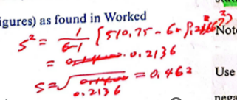

Slide 19
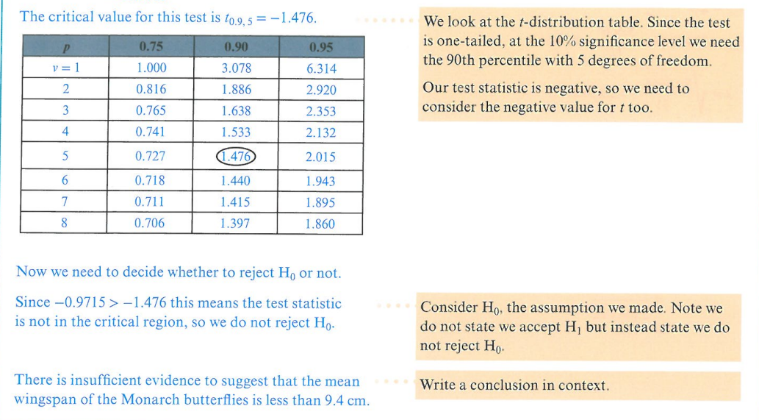
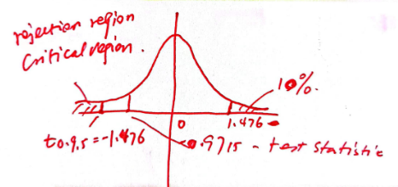


We accept $H_{0}$
In the mark schemes, it says “accept $H_{0} or$reject $H_{0}$”， so we follow mark schemes

Slide 20
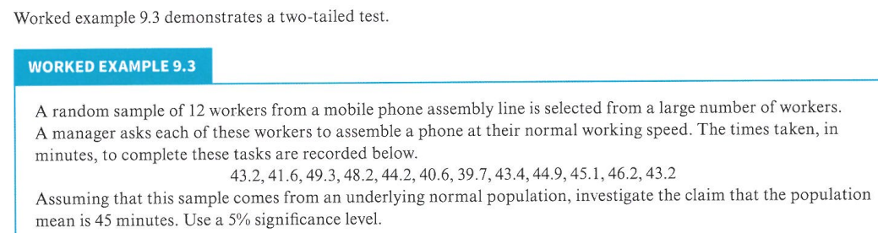
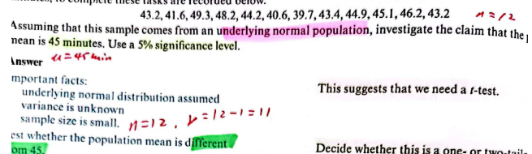

Slide 21
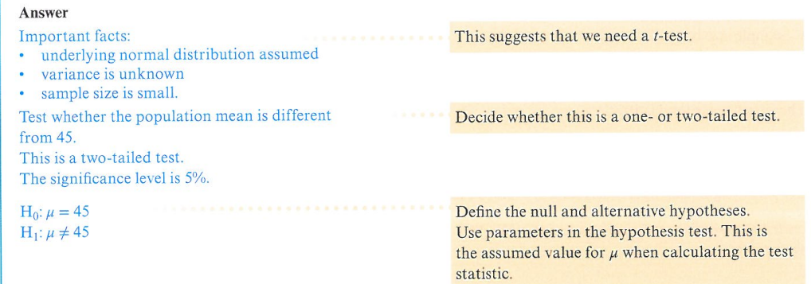
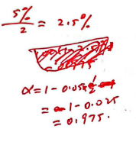

Slide 22
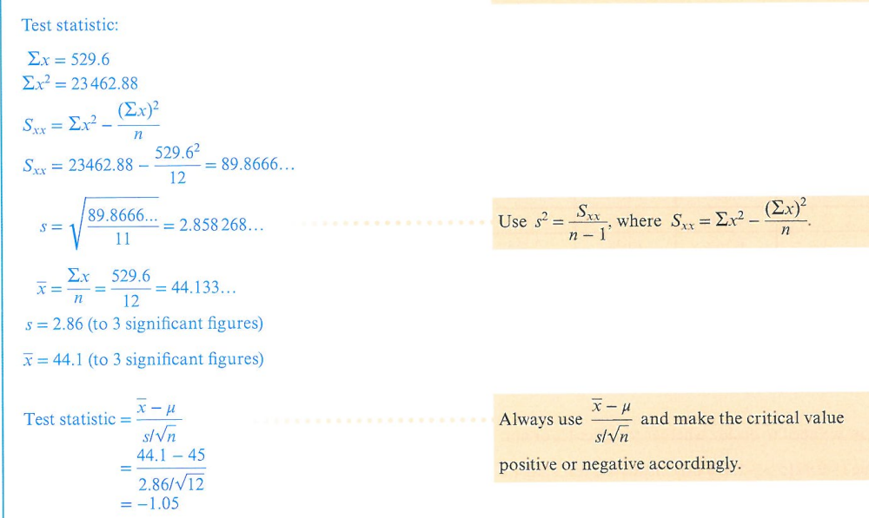
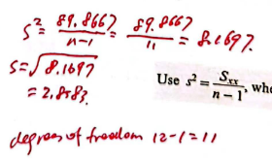
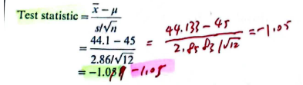

Slide 23
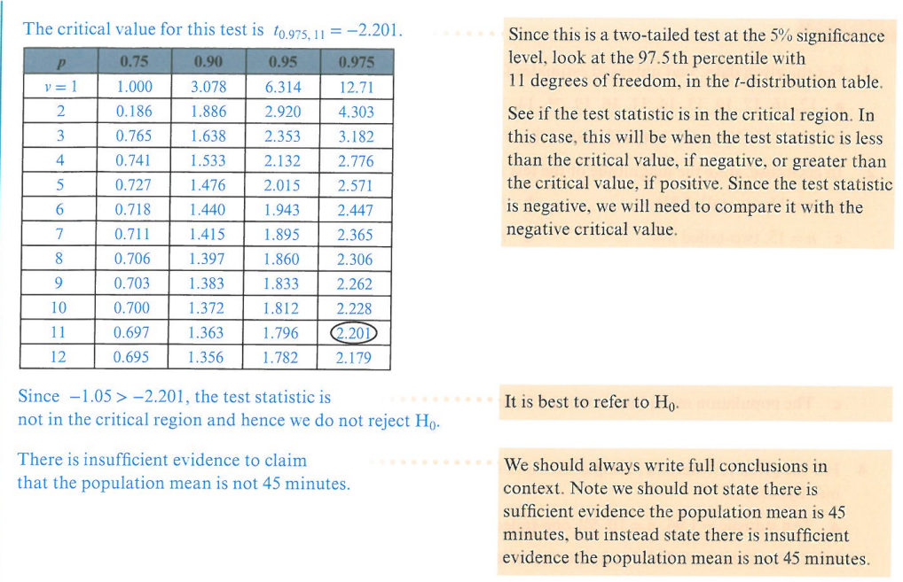
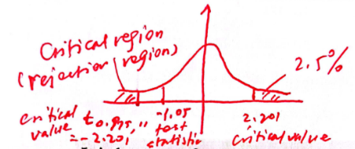

We accept $H_{0}$

Slide 24
Practice Time!

Slide 25
Exercise 9A
In class 1,2,3,4
Homework 5,6,7,8

Slide 26
The End
Thank You

